Slide 1
Data Science Retreat
Christian Wegmann

Slide 2
Agenda
1 |
The Data Science Retreat
2 |
Flying Drones With Gestures
3 |
What Did I Learn?

Slide 3
Agenda
1 |
The Data Science Retreat
2 |
Flying Drones With Gestures
3 |
What Did I Learn?

Slide 4
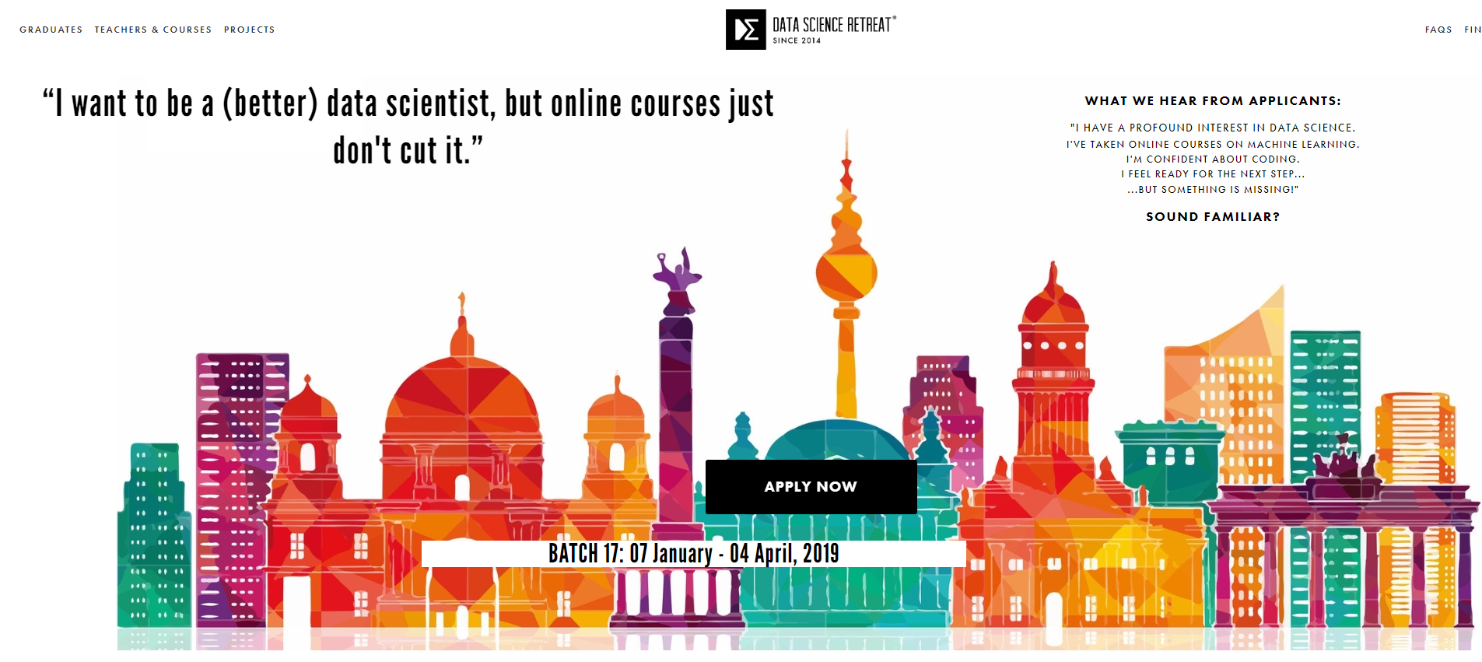
The Data Science Retreat

Slide 5

What Is Data Science?
Remember linear regression from school?
Input Value
Target Value
Target Value
Predictor:
Predictor(Input Value) = Target Value
Input Value
With the advent of big data and increased computing power researchers have developed supercharged versions of linear regressions. As this is often iterative and gets better with more data the community calls it ‘Machine Learning’.

Slide 6
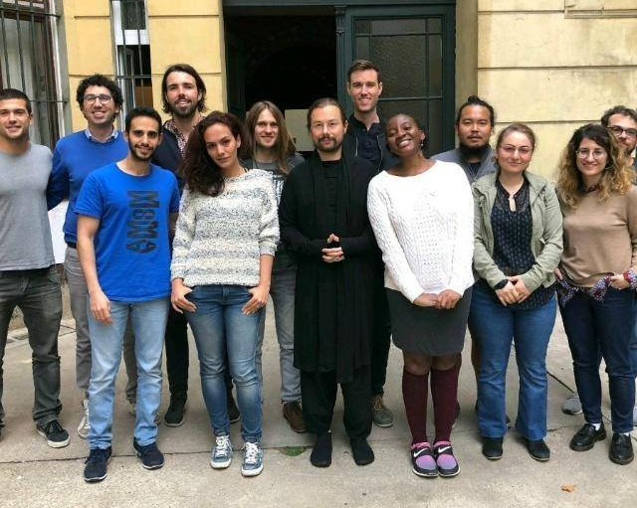
A bit More Details…
What did we learn?
Who was there?
Python: NumPy, pandas, SciKit-Learn
SQL
Streaming ML
Model optimizations in ML
Deep learning
ML with small samples, including zero-shot learning
Reinforcement learning
Microservices
Applied Machine Learning using Apache Spark
Interactive visualizations in the browser with D3
Communication skills for data scientists
Model Pipelines
14 Students
11 Nationalities
15 Teachers

Slide 7
Data science Retreat Structure
Month 1
Month 2
Month 3
Classes
Classes
Portfolio Project
Portfolio Project

Slide 8
Agenda
1 |
The Data Science Retreat
2 |
Flying Drones With Gestures
3 |
What Did I Learn?

Slide 9
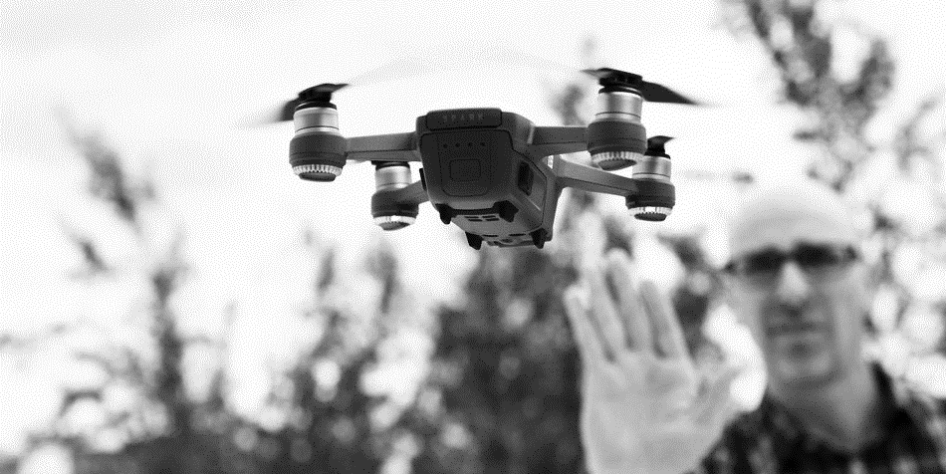
Steering DRONEs With GESTUREs

Slide 10
What Is a GESTURE?
Gestures are a sequence of body poses and allow us to be very expressive (e.g. sign language of the deaf). It is not so simple to detect and interpret though.
t₀
t₁
t₂
t₃
t
t
movement = right
Features = x_{i} , y_{i} , t_{i} , i = body joints

Slide 11
GESTURES (Seven CLASSES)
take_off
id=1
left
id=4
LAND
land
id=6
right
id=5
move
id=2
flip
id=3
We classified everything which does not match exactly one of the above gesture as ‘no gesture’.

Slide 12
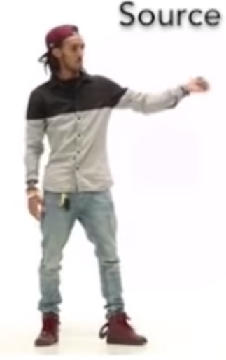
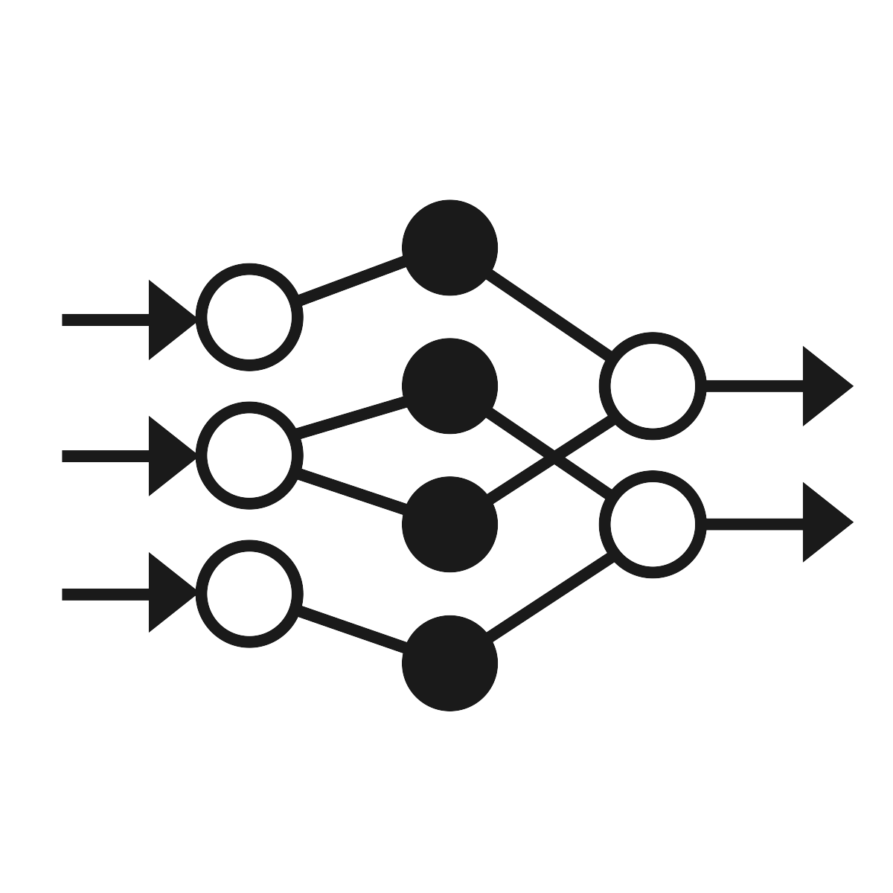


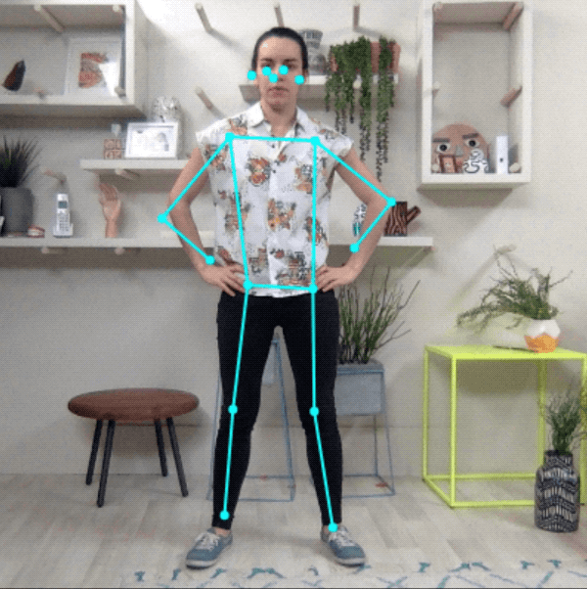
POSENET
In May 2018 the Google Creative Lab released a tensorflow.js version of PoseNet (see blog post). PoseNet is a convolutional neural network which in essence extracts the x/y coordinates of body parts from an input picture or video.
PoseNet
Video
Wireframe
…and this is how it looks:
We did a form of transfer learning by building our gesture detection model on top of the PoseNet output, i.e. the body part coordinates.

Slide 13





We had to overcome several challenges:
MUCH MORE THAN A STANDALONE MACHINE LEARNING MODEL
Real-time Requirements
Python | JavaScript | Hardware
Needs to Work Offline
Flying a drone means every millisecond counts – or we crash into a wall. The model and data pipes therefore need to be stable and performant.
PoseNet runs in JavaScript. Training neural networks is much more mature in Python. Connecting to a drone API is needed. Bringing it all together is not simple.
A drone has its own wireless network. The native PoseNet runs on Google servers – we therefore had to make it run locally, including all libraries.

Slide 14





System Components
We use a webcam to record gestures from users in real-time.
PoseNet runs on a local node.js server and is exposed via a website. It translates a video stream into a wireframe stream.
A Python websocket server consumes the wireframe stream and feeds it into a gesture model. This model extracts movements like take-off or left from the wireframe stream.
A steering module connect the drone API with the movement stream from the gesture model and ensures multi-threading and realtime movements.
PoseNet
Gesture Detection
Steering Module
Client in Chrome
Video
Server
Server
Steering Module
Wireframe
Movements

Slide 15
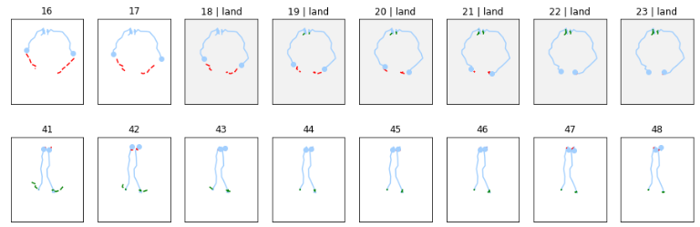
Labelling
PoseNet
Client in Chrome
t
Video
video clip of two seconds
Server
Wireframe
t
0
1
2
3
4
5
6
7
8
9
Frame-Based Labelling
We looked at frame sets one by one and labelled them, with no regard for the actual time. For this we needed to visualize a video clip in a picture.
Here we see the position of the left and right wrist over time; grey means labelled.
video
0
1
2
3
4
5
6
7
t
labelling
Legend: current position 17 previous frames
5 frames before movement 5 frames after movement

Slide 16
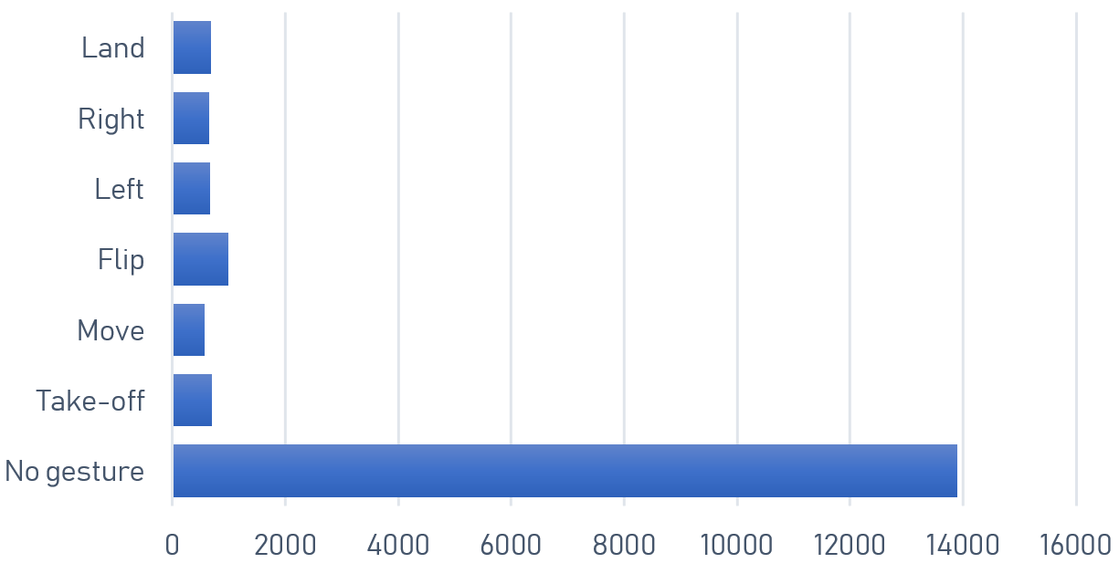
Data Improvement 1 / 2
1
Interpolation
2
Up- / Downsampling
PoseNet sends coordinates with changing intervals. We though interpolating them makes it easier for the model.
We had unbalanced data: ~75% of our data was labelled as ‘no gesture’.
t
Interpolation with cubic splines
t
While the theoretical accuracy increased we did not notice any improvement in practical tests with live streaming data.
We downsampled the ‘no gesture’ data by removing ambiguous ones
We upsampled the other data using replacement sampling
Sampling improved our accuracy noticeably
We decided to not use interpolation to reduce complexity

Slide 17
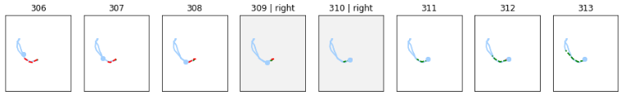
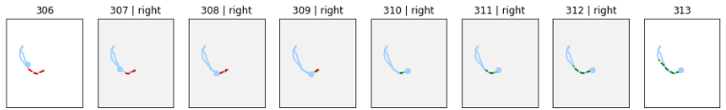
Data Improvement 2 / 2
3
Centralizing / Scaling
4
Tolerance range adaptation
PoseNet returns absolute coordinates. As the subject moves around, the measurements differ. We thus centralized and scaled the coordinates.
We labelled movements exactly. The result was that the model required very precise inputs. We relaxed the requirement and added a tolerance range.
Tolerance range = 0
Tolerance range = 2
Legend: current position 17 previous frames
5 frames before movement 5 frames after movement
Normalization proved to be the single most effective data improvement
Substantial impact on model performance

Slide 18
Model Selection
1
Random Forest
Usually robust, generalize well and do not need a lot of hyperparameter tuning.
Candidate for baseline classifier
Test Accuracy: 0.95
2
Support Vector Machine
Known to work well for classification tasks when there is not a lot of data
Test Accuracy: 0.93
3
Long Short-Term Memory (LSTM)
Type of recurrent neural network (RNN) that can store past information
Suited for sequence classification
Test Accuracy: 0.97
In theory all our models achieved high accuracy – but this did not automatically translate to high accuracy in live streaming data.

Slide 19
Let us Fly.
A live demo with our Tello drone.

Slide 20

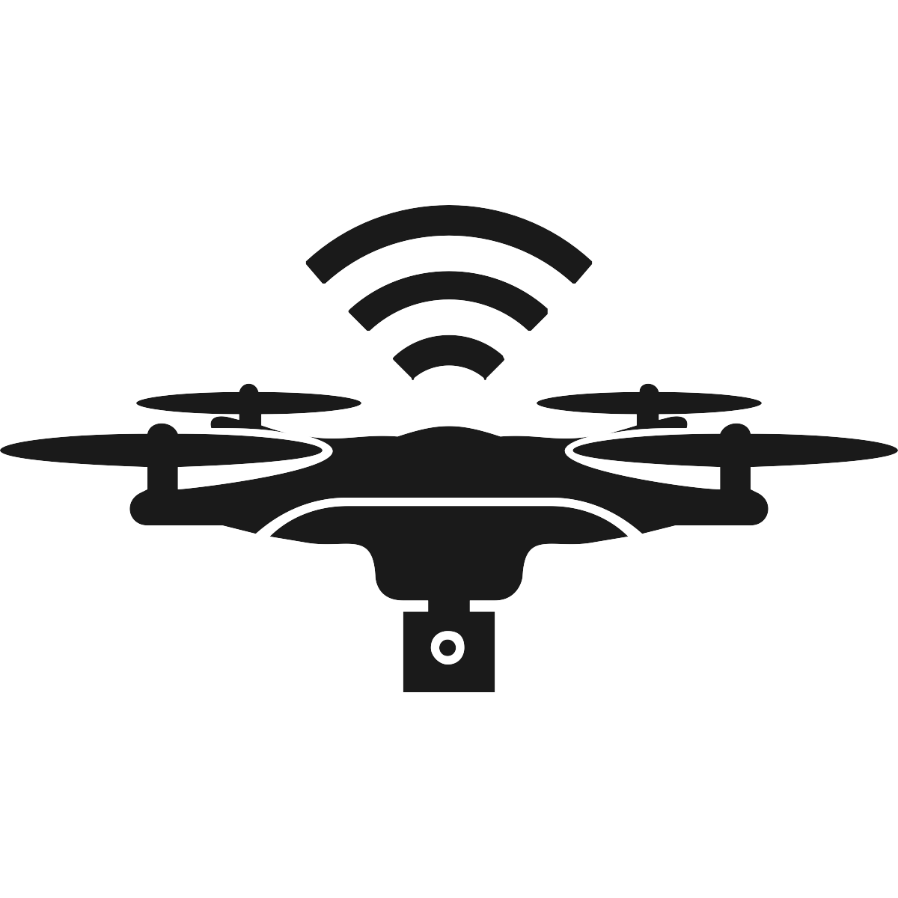

Possible Improvements and Next Steps
Data
Collect more (and more representative) training data
Train more complex and different length gestures
Use data augmentation for time series¹
Extract wireframes several times for a given video
Drone
Use advanced drone
Capture video signal directly from drone
Performance
Use better hardware
Optimize runtime performance for live prediction
Use more sophisticated model²
1 Data augmentation using synthetic data for time series classification with deep residual networks [arXiv:1808.02455v1 [cs.CV] 7 Aug 2018]
2 LSTM Fully Convolutional Networks for Time Series Classification

Slide 21



Potential for Commercialization
Search & Rescue
Toys
Camera Drones

Slide 22
Agenda
1 |
The Data Science Retreat
2 |
Flying Drones With Gestures
3 |
What Did I Learn?

Slide 23
What Did I Learn?
Tech
Tech industry is fun to work in – many young and enthusiastic people
All that glitters is not gold: there is a lot of hype about tech, data science, AI and Berlin as the new Silicon Valley, but in the end not so much to show (yet)
Work
Notebook style of working might be very suitable for some of our work (demo)
Machine learning and neural networks can be very powerful and will be used much more pervasively in the future
In GRA, we can use some of the tools, but not so much machine learning / neural networks
There is a whole world of data beyond our data warehouses. We had one class about SQL – out of 30+. And many data scientists do not bother so much with SQL.
Personal
Meetups are a good place to see new technology, ideas and people
It’s very good to get out of our little Swiss Re world for three months, have time to work uninterrupted on a project and meet a completely new set of people
Berlin is great to live in and still very lively – but on cold indicators it is behind sugarcoated Zürich in many ways (cleanliness, acceptance of plastic money, infrastructure, slow and paper-based city administration, care for homeless people)

